Slide 1
NON PATHOGENIC BACTERIA OF RHIZOBIUM AND AZOTOBACTER
Presented by:Shaik Reshma
Msc.Microbiology

Slide 2
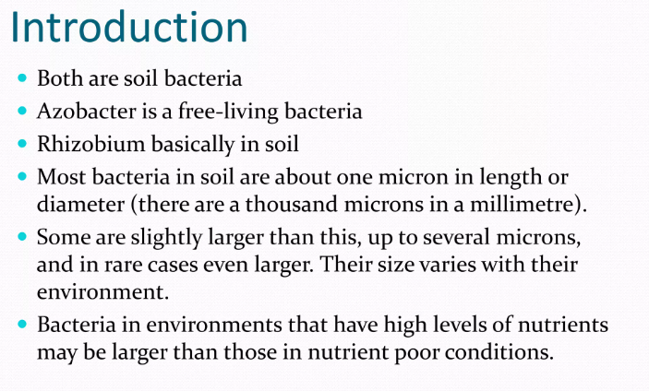

Slide 3
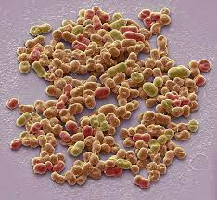
AZOTOBACTER

Slide 4
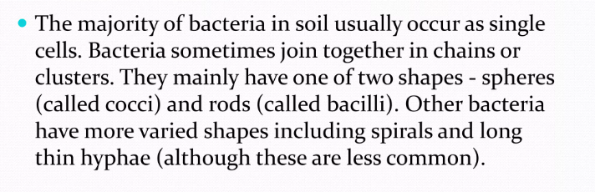
SOIL BACTERIA

Slide 5
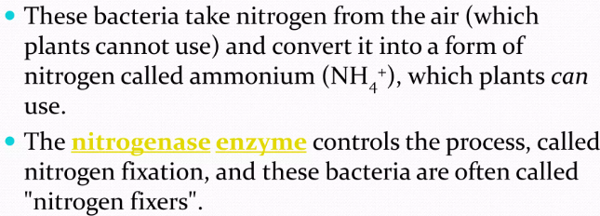
AS NITROGEN FIXER

Slide 6
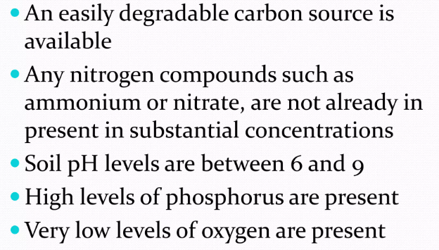
It converts atmospheric nitrogen in to ammonium,but in the conditions of:

Slide 7
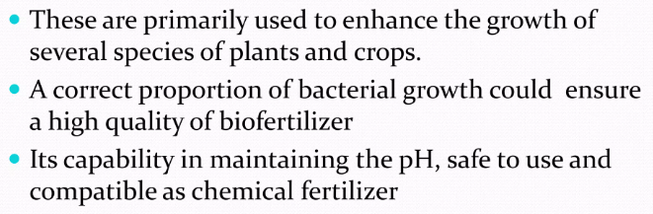
BENEFITS AS BIO FERTILIZER

Slide 8
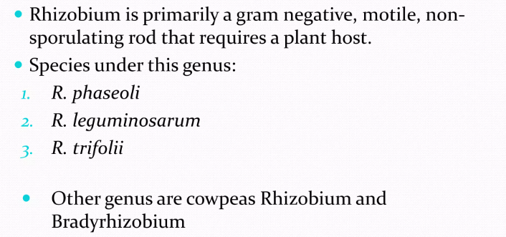
RHIZOBIUM

Slide 9
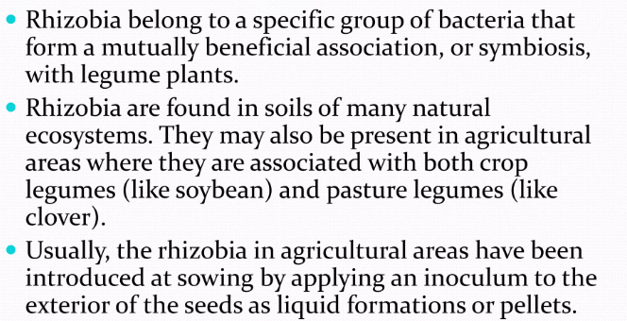
IN AGRICULTURE

Slide 10
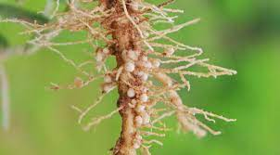
RHIZOBIUM

Slide 11
THANK YOU

